Slide 1
Big Data Analysis of Netflix Userbase
Presented by: Soomin, Nicholas, Yehonatan
Date: December 10, 2024

Slide 2
Dataset Overview
Dataset Source: Netflix Userbase Dataset
The dataset provides a snapshot of Netflix users, highlighting subscriptions, revenue, account details, and activity.
Each row represents a user, with information on subscription type, monthly revenue, join date, last payment date, country, and device type (e.g., Smart TV, Mobile).
It includes 10 columns and 2,500 rows, offering insights into user behavior and preferences.

Slide 3
Dataset Description
User ID: A unique integer identifier for each user. (Example: 1, 2, 3)
Subscription Type: The subscription plan type the user is subscribed to. (Example: "Basic", "Premium", "Standard")
Monthly Revenue: The monthly revenue generated by the user, represented in integer format. (Example: 10, 15, 12)
Join Date: The date when the user joined the platform. (Example: “01-05-23", “18-03-22")
Last Payment Date: The most recent date when the user made a payment. (Example: “01-05-23", “18-03-22")
Country: The country where the user is located. (Example: "United States", "Canada", "Germany")
Age: The age of the user in years. (Example: 28, 35, 42)
Gender: The gender of the user. (Example: "Male", "Female")
Device: The primary device used to access the service. (Example: "Smartphone", "Tablet", "Smart TV")
Plan Duration Days: The subscription duration plan. (Example: 600,425)

Slide 4
Data Cleaning and Transformation
Converted categorical data into numerical values
Subscription Type: ['Basic-0 ', 'Premium-1', 'Standard-2']
Country: ['Australia-0', 'Brazil-1', 'Canada-2', 'France-3', 'Germany-4', 'Italy-5', 'Mexico-6', 'Spain-7', 'United Kingdom-8', 'United States-9']
Gender: ['Female-0', 'Male-1']
Device: ['Laptop-0', 'Smart TV-1', 'Smartphone-2', 'Tablet-3']
2) Deleted meaningless column
=> Plan_Duration
3) Adding column
=> Plan_Duration_days (Last Payment Date - Join Date )

Slide 5
Features Before Data Processing
Feature | Example Values | Type | Size
User ID | 1,2,3,4......2000 | Integer | 4
Subscription Type | Basic,Standard,Premium | String | 10
Monthly Revenue | 10,12,15 | Integer | 2
Join Date | 01-05-23, 18-03-22... | String | 8
Last Payment Date | 01-05-23, 18-03-22... | String | 8
Country | Germany, France, Mexico... | String | 16
Age | 28,35,42.... | Integer | 2
Gender | Male,Female | String | 6
Device | Smartphone,Tablet,laptop.... | String | 16
Plan Duration(Days) | 600, 425.... | Integer | 4

Slide 6
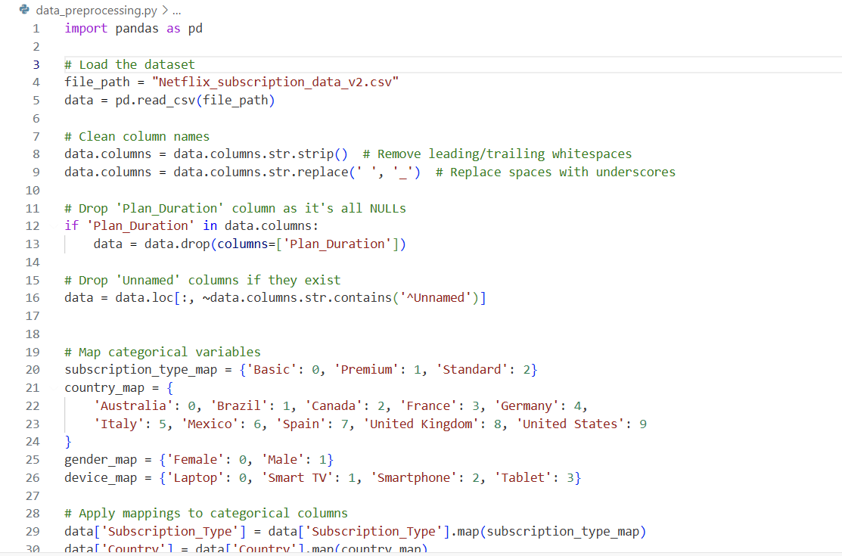
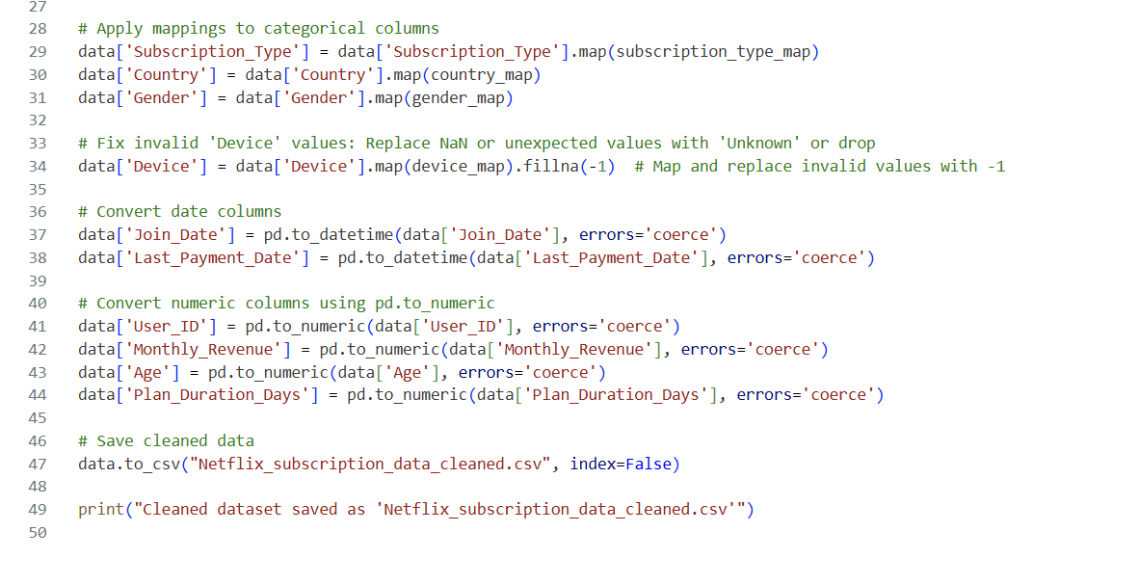
Data Processing
<= Using pandas
Data flow
<= Drop null data
<= Encoding categorical data

Slide 7
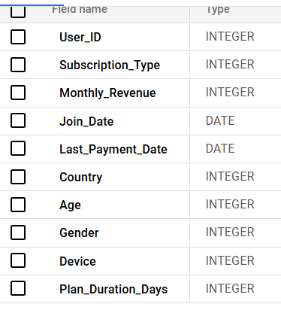
Schema After Data Processing
Stored in cloud storage

Slide 8
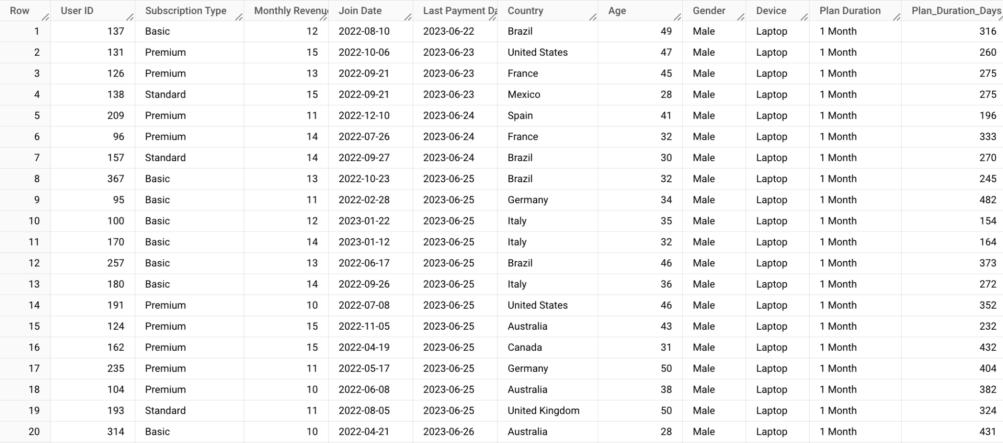
Data Before Processing

Slide 9
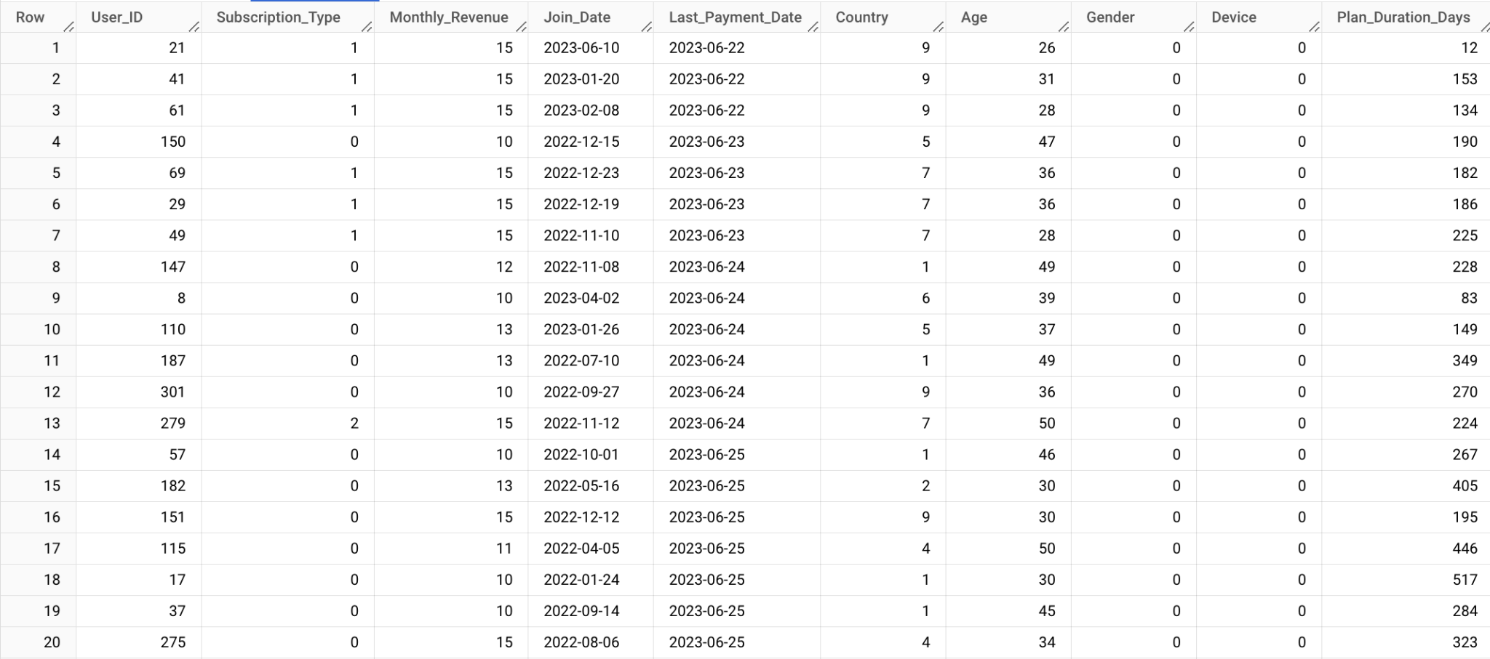
Cleaned Data

Slide 10
Key Questions
1. Revenue Analysis
1) How has total monthly revenue changed over time, and what growth patterns can be identified?
2) How does revenue distribution vary by country, and what can be inferred about the market value of each region?
2. Identifying Key User Groups
3) What devices are most preferred by the key user groups?
4) Which subscription plans are most popular among the key user groups?
Notes:
Soomin
We divided our analysis into two sections and defined the key questions for each.

Slide 11
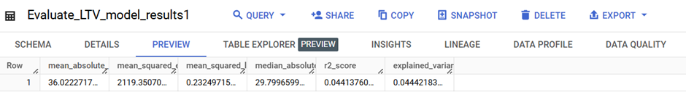
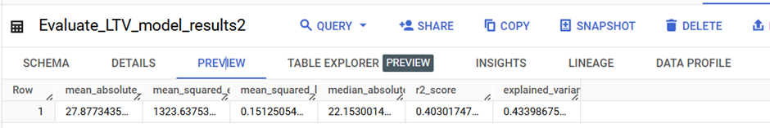
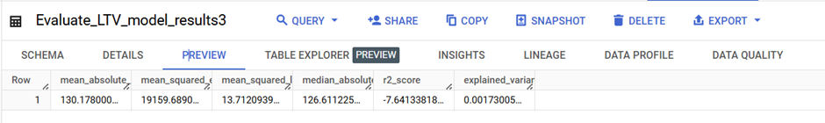
Results1
Revenue Analysis
LTV(lifetime value)=
Monthly_Revenue * Plan_Duration_Days / 30
Model 1: linear reg,
Model 2: Boosted Tree reg,
Model 3: DNN reg
Notes:
Soomin
To analyze revenue, we first created a regression model to calculate customer LTV (Lifetime Value). The formula used was:
LTV (Lifetime Value) = Monthly_Revenue * Plan_Duration_Days / 30
We implemented three models:
Model 1: Linear Regression
Model 2: Boosted Tree Regression
Model 3: DNN Regression
Among these, the Boosted Tree Regression had the highest explained variance, but it was still only 0.4.

Slide 12
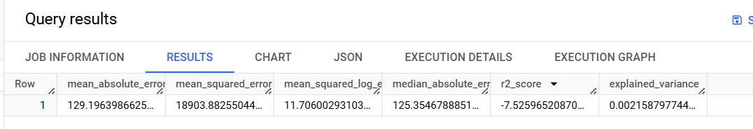
Results 1
Revenue Analysis
Tried to update model 2
with changing
max_iterations, learn_rate, subsample..
but it became worst
We can tried to update model with scale the data
Notes:
Soomin
We attempted to improve the results by adjusting parameters such as max_iterations, learn_rate, and subsample, but the performance worsened. We believe this is because the dataset lacked distinct features, and the amount of data was insufficient.
We anticipate that scaling the data to a range of 0-1 and rerunning the models might yield better results.

Slide 13
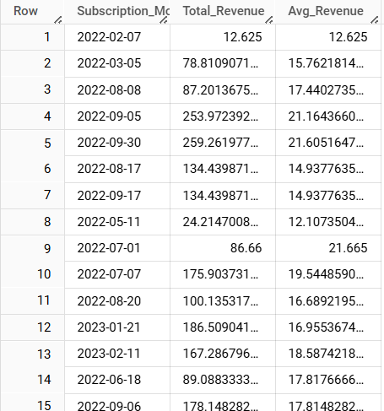
Results1
How has total monthly revenue changed over time, and what growth patterns can be identified?
Revenue saw accelerated growth from Q2 to Q3 2022, likely driven by seasonal campaigns or strategic initiatives, followed by stabilization in 2023, sustaining the higher revenue levels achieved.
Notes:
Soomin
To answer the first question, we analyzed the changes in total revenue over time based on LTV.

Slide 14
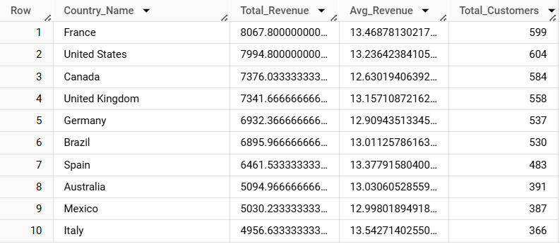
Results1
2) How does revenue distribution vary by country,
and what can be inferred about the market value of each region?
France and the United States lead in total revenue and customer counts, making them the most valuable markets. Emerging markets like Brazil and Spain show growth potential, while Italy, despite lower customer numbers, stands out with the highest average revenue per customer, indicating opportunities for targeted premium strategies.
Notes:
Soomin
To answer the second question, we analyzed the differences in total revenue by region based on LTV.

Slide 15
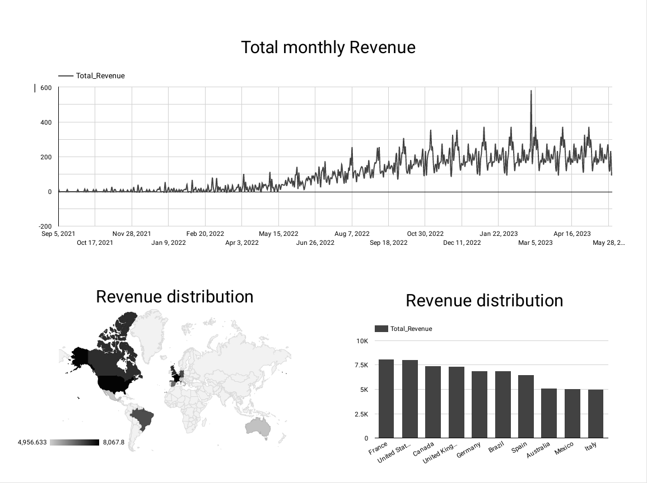
Notes:
Soomin
I visulize this with looker studio

Slide 16
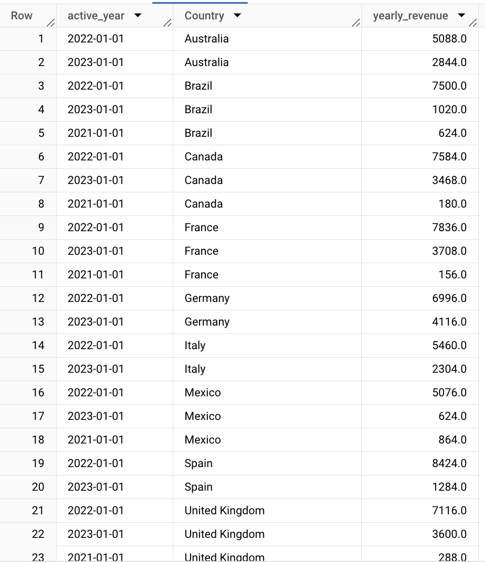
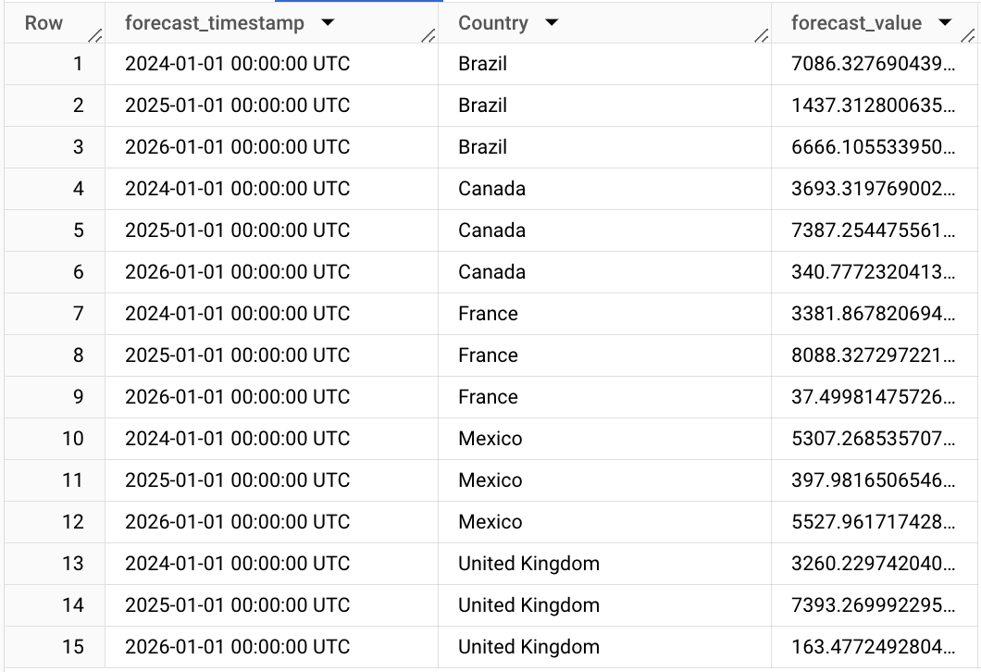
Arima Model:Forecasting Future Years Revenue
2) How does revenue distribution vary by country, and what can be inferred about the market value of each region?
Actual Values
Forecasted Values

Slide 17
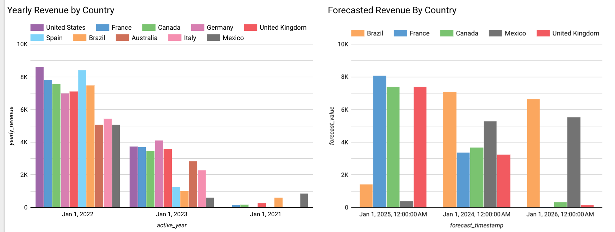
Results of Arima Model

Slide 18
Arima Model V2
Instead of year to year, built model to predict month to month.
Saw much better results

Slide 19
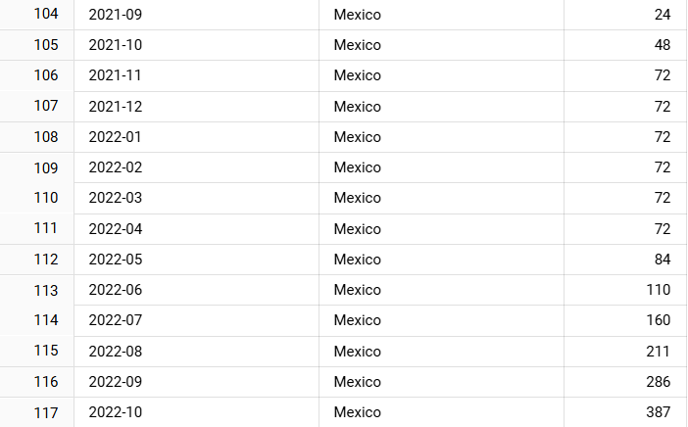
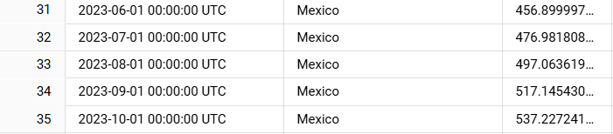
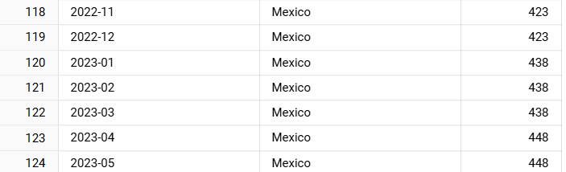
Arima Model V2
=>

Slide 20
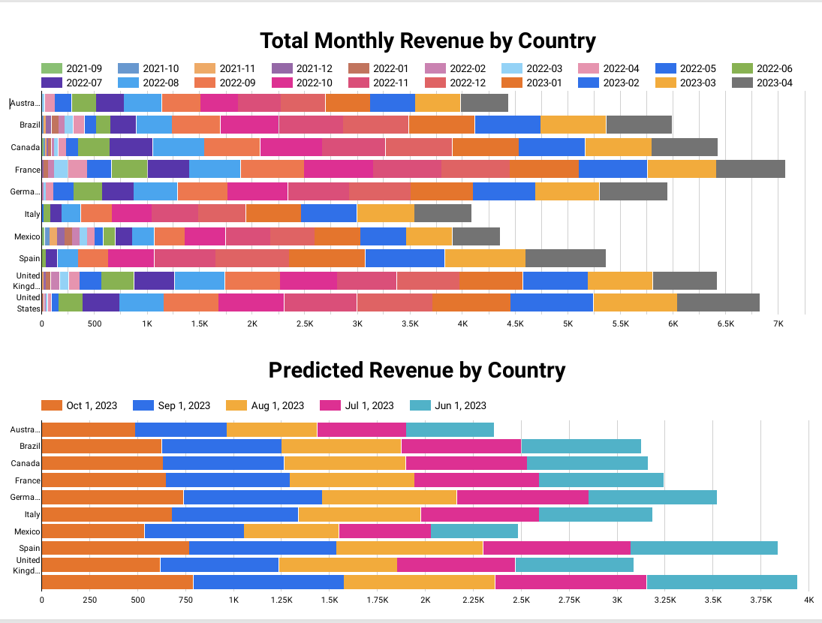

Slide 21
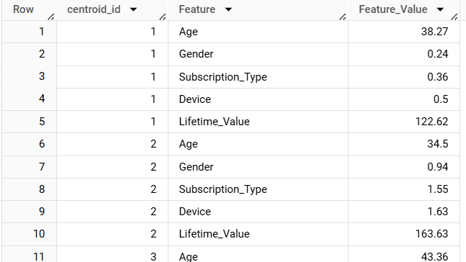
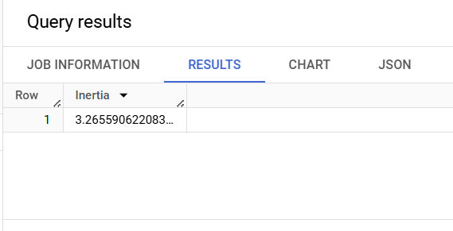
Results
Identifying Key User Groups
Tried to cluster the users to figure out key user groups
Model: K-mean
Result of cluster
Result of model evaluating
Notes:
Soomin
So for the second section, we want to Identifying Key User Groups.
Using a K-means model, we created five groups with distinct characteristics. The model's performance was evaluated using inertia, which was 3.2, indicating a reasonable result.

Slide 22
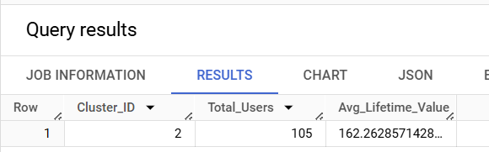
Results
Identifying Key User Groups
Finding Key user group: (based on LTV)
Notes:
Soomin
Among these groups, we identified the group with the highest LTV and analyzed its characteristics. Group 2 was identified as having the highest LTV.

Slide 23
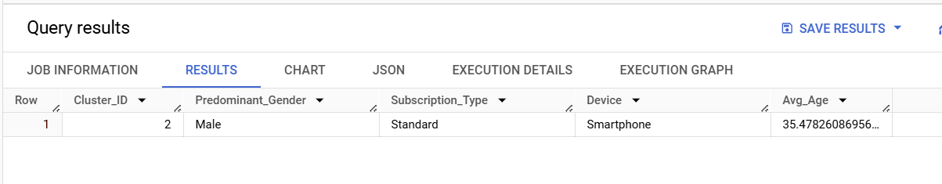
Results
3) What devices are most preferred by the key user groups?
The data indicates that smartphones are the most preferred devices among key user groups. This suggests that the majority of users in the group rely on mobile access for the service, emphasizing the importance of optimizing the platform for mobile use.
4) Which subscription plans are most popular among the key user groups?
The most popular subscription plan among the key user groups is the Standard plan. This likely reflects a preference for mid-tier features or pricing, balancing affordability and functionality.
Notes:
Soomin
Upon analyzing the characteristics of Group 2, it was found to consist mainly of males with an average age of 35. They primarily used the Standard subscription plan and watched Netflix mostly on smartphones.

Slide 24
Limitations
Not many features, harder to get meaningful analysis
Some features were redundant or unnecessary
Time - Would like to have done more models

Slide 25
Future Work
Look into separating the data by each country to do more in depth analysis
Run the forecast over a longer period of time to see how the data changes.

Slide 26
Thank You!

